Slide 1

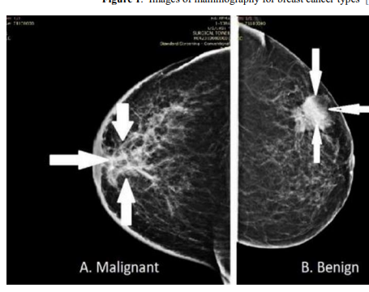
MACHINE LEARNING APPROACHES – TO CLASSIFY BREAST CANCER (TO PREDICT BREAST CANCER)
Fitchburg State University
SP23_Intro to Data Science-52 Instructor: Prof Ricky Sethi Student Name: Yasaswini Nallapula Student ID: ( )

Slide 2

Analysis
The identification of cancerous cells in the human body is a lengthy process. Also, the longer it takes to detect cancer, the more difficult it is to treat. Therefore, in this project, we aim to develop a model that can automatically detect breast cancer with high accuracy based on the measured values ​​of biopsy cells of women with abnormal breast masses.
We used the Wisconsin breast cancer diagnostic dataset containing 569 observations from the UCI repository. Our goal is to create a classification model that can classify biopsy data points as benign (noncancerous) or malignant (cancerous).

Slide 3
Dataset
Dataset source: https://archive.ics.uci.edu/ml/datasets/breast+cancer+wisconsin+(diagnostic)
Observations – 569
Variables – 32
Input features:
a) radius (mean of distances from the center to points on the perimeter) b) texture (standard deviation of gray-scale values) c) perimeter d) area e) smoothness (local variation in radius lengths) f) compactness (perimeter^2 / area - 1.0) g) concavity (severity of concave portions of the contour) h) concave points (number of concave portions of the contour) i) symmetry j) fractal dimension ("coastline approximation" - 1)
Target feature: Diagnosis (M = malignant, B = benign)

Slide 4
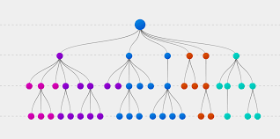
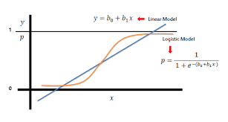
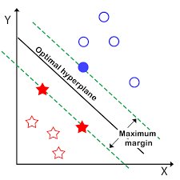
Models
There are three machine learning methods that are applied to our classification models:
Decision tress
Logistic Regression
Support vector Machines(SVM)
We will measure the performance of each model and compare the accuracy rate to find the best model amongst them. The platform being occupied for our analysis is R studio.
For Model Optimization, we will perform - Gradient Boosting machine

Slide 5
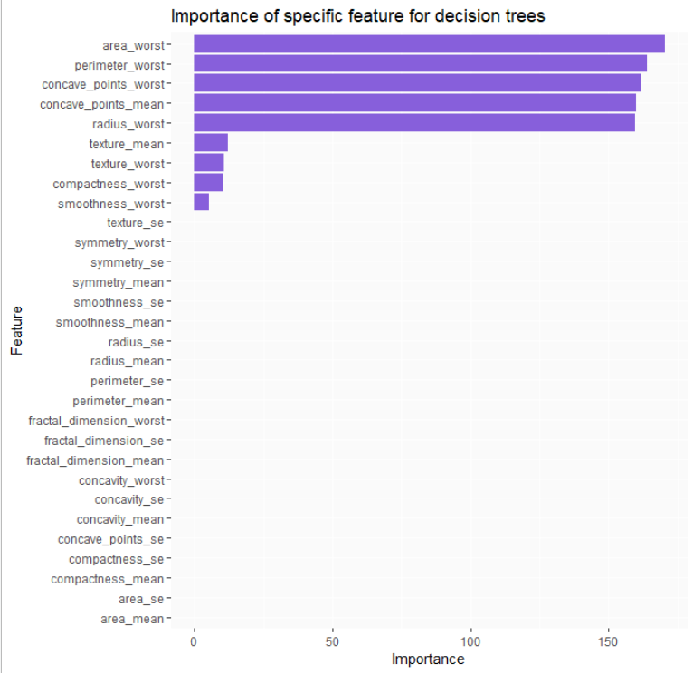
Decision trees: CART (Classification and regression tree) Model

Slide 6
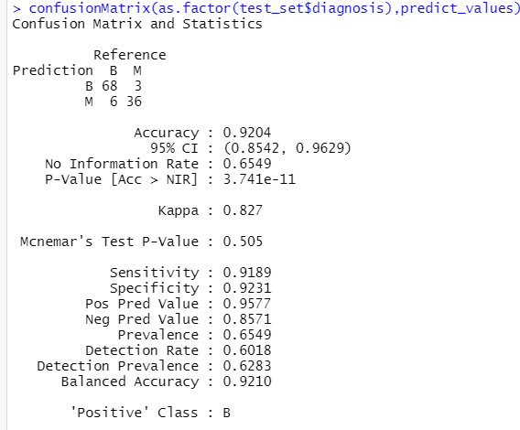
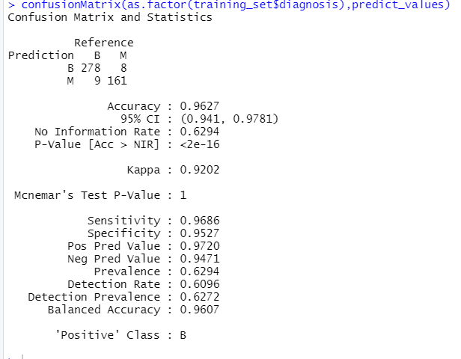
Decision trees: CART (Classification and regression tree) Model
Test data Accuracy:
Train data Accuracy:

Slide 7
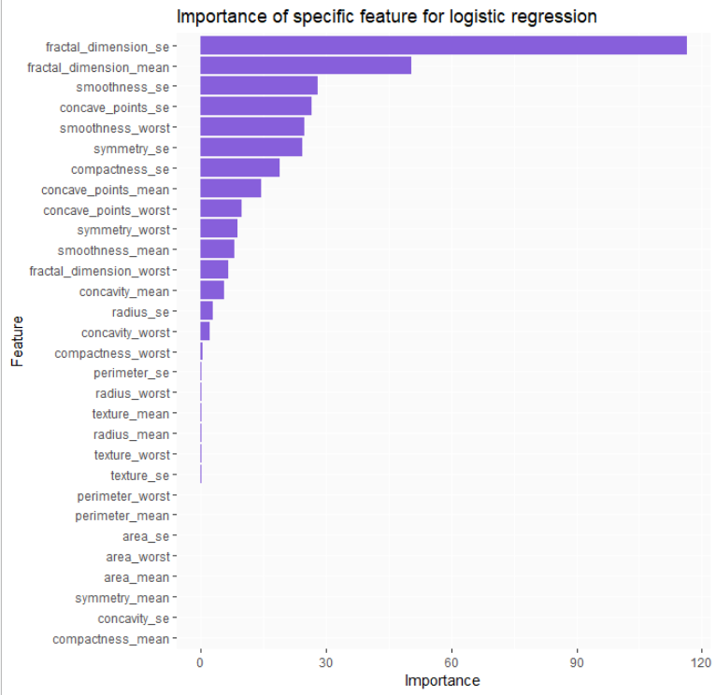
Logistic Regression (Binary Classification):

Slide 8
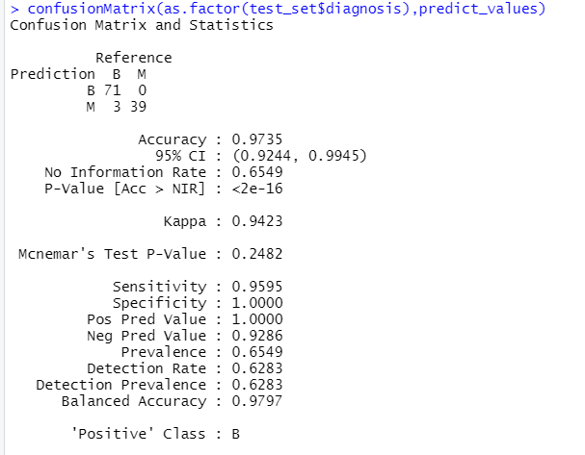
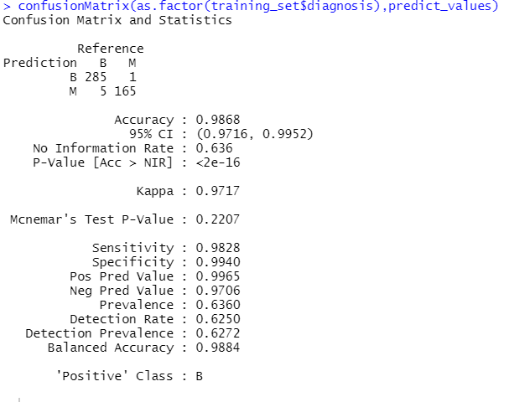
Logistic Regression (Binary Classification):
Test data Accuracy:
Train data Accuracy:

Slide 9
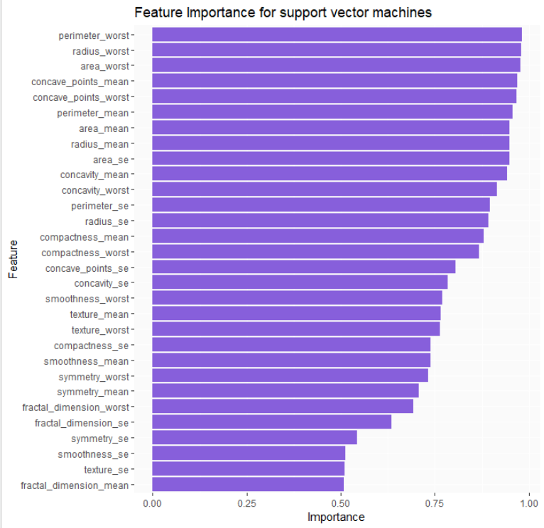
Support Vector machines
(SVM):

Slide 10
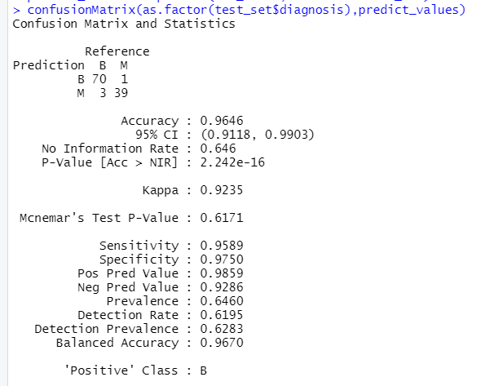
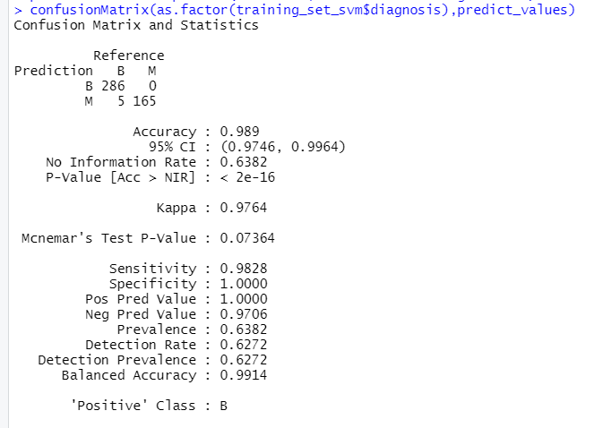
Support Vector machines(SVM):
Test data Accuracy:
Train data Accuracy:

Slide 11
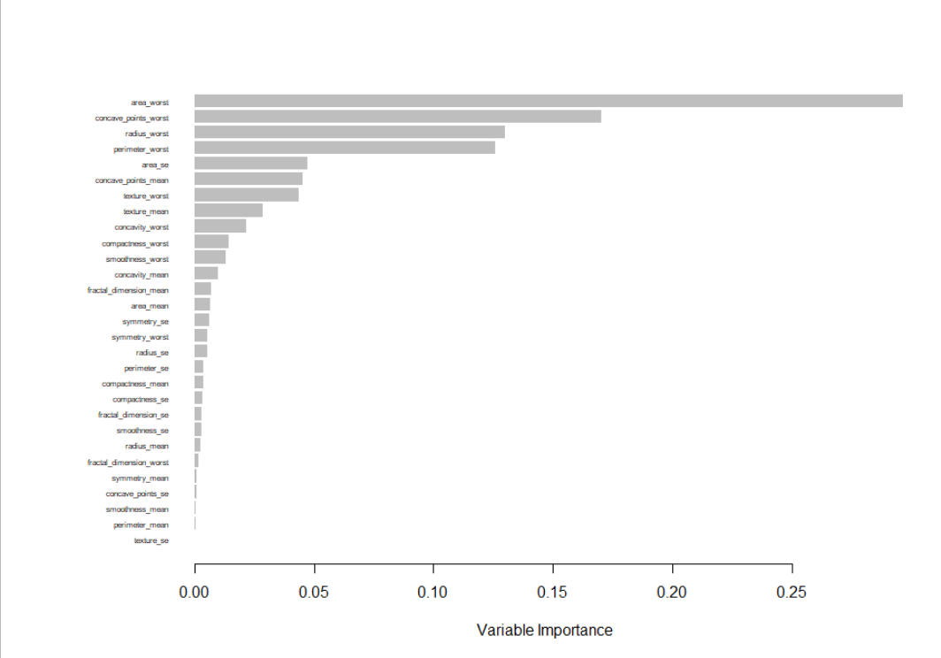
Gradient Boosting Machine:

Slide 12
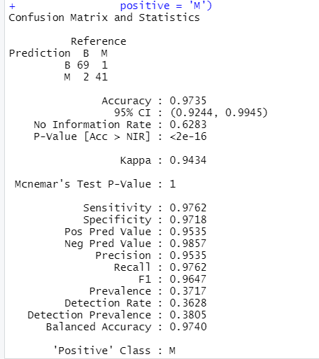
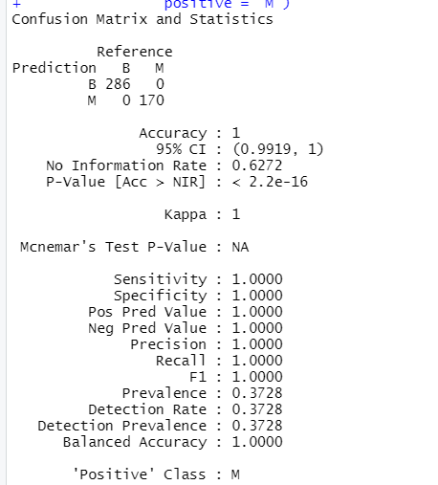
Gradient Boosting Machine:
Test data Accuracy:
Train data Accuracy:

Slide 13
Malignant or Benign: Results
Classifier | Train Accuracy | Test Accuracy
Decision Tree | 96.27% | 92.04%
Logistic Regression | 98.6% | 97.35%
SVM | 98.9% | 96.46%
Gradient Boosting Model | 100% | 97.35%

Slide 14
Conclusion
All four models performed well on both train and test data however, SVM being a non-linear classification was able to generalize input features to target feature mapping well in determining and establishing the relationships well on non-linear space.
Gradient boosting model predicted with an accuracy of 97.35% and 100% for the test and training datasets. ROC curves of the 5-fold cross validated hyperparameter searches had high AUC values (AUC = 99%, AUC = 98.9%) indicated that the training model performed well at classification and indicates a great ability to distinguish between a benign lump and a malignant tumor.

Slide 15

Further Analysis & Drawbacks:
Medical history needs to be collected.
Demographic details need to be included.
For practical reasons, if the number of observations is small, I should know how to sample or collect the data.

Slide 16
References:
https://towardsdatascience.com/building-a-simple-machine-learning-model-on-breast-cancer-data-eca4b3b99fa3
https://rstudio-pubs-static.s3.amazonaws.com/411600_3185f5d17d104cc5beb4587094b905e9.html
https://www.ncbi.nlm.nih.gov/pmc/articles/PMC7351679/
https://ieeexplore.ieee.org/abstract/document/8391468

Slide 17

Thank you !!

